Slide 1

What Are Protected Characteristics?

Slide 2
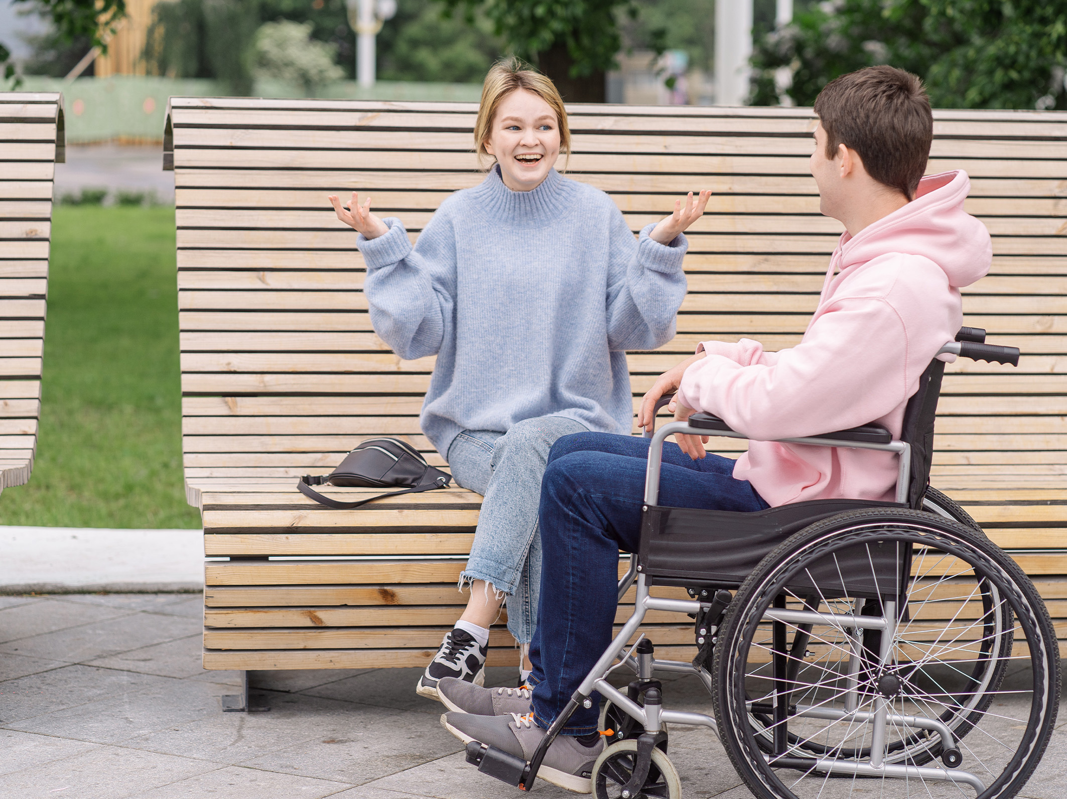
Teacher Note
This resource is provided for informational and educational purposes only and does not constitute legal advice. If you require legal advice, you should contact a suitably qualified professional. You should not rely on the material included within this resource and Twinkl does not accept any responsibility if you do. Sensitive and/or upsetting topics may emotionally impact your students due to past experiences. You should consider whether this content is appropriate and ensure adequate support is available for anyone affected.
This resource contains links to external websites. Please be aware that the inclusion of any link in this resource should not be taken as an endorsement of any kind by Twinkl of the linked website, or any association with its operators. You should also be aware that we have no control over the availability of the linked pages. If the link is not working, please let us know by contacting TwinklCares and we will try to fix it although we can assume no responsibility if this is the case. We are not responsible for the content of external sites.

Slide 3

What Are Protected Characteristics?
Protected characteristics are aspects of a person’s identity that are protected under the Equality Act 2010. This law makes it illegal to discriminate against someone based on these characteristics, helping to promote a fairer and more equal society.
The nine protected characteristics are:
age
disability
gender reassignment
marriage and civil partnership
pregnancy and maternity
race
religion or belief
sex
sexual orientation

Slide 4
The Equality Act 2010
The Equality Act came into force on 1st October 2010. It brings together over 116 separate pieces of legislation into a single act.
The Equality Act 2010 lays out a legal framework to protect the rights of individuals and advance equality of opportunity for all. It provides Britain with a discrimination law that prevents individuals from facing unfair treatment.

Slide 5
The Equality Act 2010
Under the Equality Act 2010, you are protected from discrimination:
when you are in the workplace,
when you use public services like healthcare (for example, visiting your doctor or local hospital) or education (for example, at your school or college),
when you use businesses and other organisations that provide services and goods (like shops, restaurants, and cinemas),
when you use transport,
when you join a club or association (for example, your local tennis club),
when you have contact with public bodies like your local council or government departments.

Slide 6
What Is Discrimination?
Discrimination is the unfair or prejudicial treatment of people and groups based on protected characteristics. It often stems from negative stereotypes. For example, stereotypes about sex and gender can lead to sexism, and stereotypes about race can lead to racism. Acts of discrimination may include persecution, harassment or bullying.
Prejudice is the judgement of someone or something without knowing enough information about that person or thing. This might include dislike or hostility based on preconceived and unfounded opinions. For example, stereotypes about sexual orientation can lead to homophobia. Prejudice may also lead to discrimination.
A hate crime is any criminal offence that is perceived to be motivated by hostility or prejudice based on disability, race, religion, sexual orientation or transgender identity.
It is important for us to be informed about these issues, because both students and teachers may experience discrimination in schools. For example, data shows that UK schools have recorded more than 60 000 racist incidents in the past five years,¹ but real figures are believed to be much higher.
¹ UK Schools Record More than 60,000 Racist Incidents in Five Years (The Guardian)

Slide 7
How Can You Be Discriminated Against?
There are four main types of discrimination:
Direct Discrimination
Treating one person differently or worse than another person because of a protected characteristic.
Harassment
Treating someone in a way that violates their dignity or creates a hostile, degrading, humiliating or offensive environment.
Victimisation
Treating someone unfairly because they are taking action against someone under the Equality Act (like making a complaint about discrimination), or if they are supporting someone else who is doing so.
Indirect Discrimination
This can happen when an organisation implements a rule, policy or way of doing things that has a worse impact on people with a particular protected characteristic.

Slide 8
Disability
The Equality Act 2010 protects people against discrimination based on any disabilities that they may have.
This includes any long-term physical or mental health conditions that impact a person’s ability to carry out day-to-day activities.
Discrimination against people based on disability is referred to as ableism. It is typically based on irrational hatred, intolerance and fear of people with disabilities.

Slide 9
Invisible Disabilities
Invisible disabilities (or hidden disabilities) are disabilities that are not visible from the outside. The term ‘invisible disability’ exists as an umbrella term that captures a whole spectrum of hidden disabilities, chronic medical conditions and other challenges.
Other people may struggle to recognise an invisible disability because they cannot see physical evidence of it. As a result, people with invisible disabilities can sometimes find it difficult to access the support they need as their disability is not always understood by others.
What examples of invisible disabilities can you think of?
0:00
0:30
1:00
1:30
2:00
Start Timer

Slide 10
Invisible Disabilities
Invisible disabilities (or hidden disabilities) are disabilities that are not visible from the outside. The term ‘invisible disability’ exists as an umbrella term that captures a whole spectrum of hidden disabilities, chronic medical conditions and other challenges.
Other people may struggle to recognise an invisible disability because they cannot see physical evidence of it. As a result, people with invisible disabilities can sometimes find it difficult to access the support they need as their disability is not always understood by others.
What examples of invisible disabilities can you think of?
Autoimmune conditions
Autism/ASC
Visual impairments
Hearing loss
Learning disabilities
Breathing problems

Slide 11
Race
The Equality Act 2010 protects people against discrimination based on their race.
Prejudice and discrimination against people based on the colour of their skin or the racial or ethnic group to which they belong is referred to as racism. It takes many forms and can happen in many places, but is typically targeted at minority or marginalised groups.
The racial discrimination that is embedded into the laws and regulations of a certain society, organisation or culture is referred to as systemic racism. It is often based on historical racial inequality.
Xenophobia refers specifically to the discrimination or prejudice against people from different countries. Xenophobia is something that may be experienced by people from immigrant populations.
Racially motivated hate crimes are the most common type of hate crime reported in the UK. There were over 85 000 racially motivated offences recorded in 2020/2021.²
² Racism in the UK (Stop Hate UK)

Slide 12
Religion or Belief
The Equality Act 2010 protects people against discrimination based on their religion or beliefs.
This includes the six main religions (Judaism, Islam, Christianity, Hinduism, Buddhism and Sikhism), as well as other religions like Rastafarianism, Scientology or Paganism. It also refers to specific sects within a religion, such as Jehovah’s Witnesses or Orthodox Jews.
Antisemitism describes prejudice and discrimination against Judaism and Jewish people. It is typically based on irrational hatred, intolerance and fear of Jewish people.
Prejudice and discrimination against Islam and against Muslim people is referred to as Islamophobia. It is typically based on irrational hatred, intolerance and fear of Islam and of Muslim people. It is often reinforced by negative and harmful attitudes towards Islam in Western media.
In the UK, statistics show that people are almost three times more likely to have prejudice against Islam than any other religion.³
³ University of Birmingham Survey Reveals Islamophobia Is the Posh Person’s Prejudice (University of Birmingham)

Slide 13
Sex
The Equality Act 2010 protects people against discrimination based on their biological sex.
Prejudice and discrimination against people based on sex or gender is referred to as sexism.
Although gender equality has come a long way in the last century, there are still many areas where sexism is commonplace.
Data shows that the UK has the 12th largest female health gap globally, meaning that women receive a significantly poorer quality of medical treatment than men.⁴
The gender pay gap refers to the difference in pay between men and women in employment. A gender pay gap still exists despite there being laws in the UK that call for equal pay.
⁴ Women’s Health Outcomes: Is There a Gender Gap? (House of Lords Library)

Slide 14
Sexual Orientation
The Equality Act 2010 protects people against discrimination based on their sexual orientation.
Homophobia is an umbrella term for prejudice and discrimination against people who identify as or are perceived to be LGBT. It also more specifically refers to prejudice and discrimination against people who identify as or are perceived to be gay. It is typically based on irrational hatred, intolerance and fear of people who identify as LGBT.
Biphobia is prejudice and discrimination against people who identify as or are perceived to be bisexual. It is typically based on irrational hatred, intolerance and fear.
Statistics show that 21% of LGBT people have experienced a hate crime or incident due to their sexual orientation and/or gender identity in the last year. ⁵
36% of LGBT people say that they do not feel comfortable walking down the street holding their partner’s hand. This increases to 58% for gay men.
⁵ LGBT in Britain - Hate Crime and Discrimination (Stonewall)

Slide 15
Gender Reassignment
The Equality Act 2010 protects people against discrimination based on gender reassignment.
Transphobia is prejudice and discrimination against people who identify as or are perceived to be transgender. It is typically based on irrational hatred, intolerance and fear.
A person whose gender identity does not align with the sex they were registered with at birth may identify as transgender or trans.
Gender reassignment is a personal process. Although some trans people do choose to take hormones or undergo surgery, all trans people are protected by the Equality Act, regardless of medical processes that they may or may not undergo.
Statistics show that 25% of trans people have experienced homelessness at some point in their life, and that 41% have experienced a hate crime or incident because of their gender identity in the last year.⁶
⁶ LGBT in Britain – Trans Report (Stonewall)

Slide 16
Age
The Equality Act 2010 protects people against discrimination based on their age.
Discrimination against people based on their age can be referred to as ageism.
There are some exceptions to the Equality Act 2010 with regards to age discrimination:
Age as a protected characteristic does not apply to students in school settings.
Direct age discrimination is permitted if there is a good reason, for example somebody that is 15 being refused a job that involves driving.
Age restrictions supported by the law are permitted, such as the legal drinking age, age of consent and age restrictions on certain material or products.

Slide 17
Marriage and Civil Partnership
The Equality Act 2010 protects people against discrimination because they are married or in a civil partnership.
It protects people with a formal legal partnership with someone either of the same sex or opposite sex.
The Equality Act 2010 does not protect people against discrimination on the basis of their relationship status if:
they are in a romantic relationship but are not married;
they are engaged to be married;
they are divorced or their civil partnership has been dissolved.

Slide 18
Pregnancy and Maternity
The Equality Act 2010 protects people against discrimination if they are pregnant, have recently given birth or are breastfeeding.
This means that a person can’t be treated unfavourably, for example not being given a promotion at work, because they are pregnant or have recently given birth.
The Equality Act 2010 also protects someone’s right to legal maternity leave, as well as their rights to medical appointments associated with their pregnancy.
A recent survey revealed that three in four mothers (77%) said they had a negative or possibly discriminatory experience during pregnancy, maternity leave, and/or on return from maternity leave.⁷
⁷ Pregnancy and Maternity-Related Discrimination and Disadvantage (HM Government)

Slide 19
What Is Intersectionality?
Intersectionality is the acknowledgement that people who belong to more than one marginalised group are likely to experience different levels of discrimination as a result of this. The term was coined by Kimberlé Crenshaw, who says, “Intersectionality is about how certain aspects of who you are will increase your access to the good things or exposure to the bad things in life.”
For example, reports show that the UK has a gender pay gap of 7.9% and an ethnicity pay gap of 4.1% for ethnic minorities born in the UK, and 10.4% for ethnic minorities born outside of the UK.^{8,9} This means that, on average, women and ethnic minorities earn less, and the combination of these factors means that a Black woman, for example, is likely to earn significantly less than a White man.
It is important to consider intersectionality when discussing discrimination, as people often belong to more than one marginalised group. An understanding of intersectionality allows us to foster a culture of acceptance and inclusivity.
Nevertheless, discrimination of any kind is unacceptable and should not be tolerated.
⁸ Gender Pay Gap in the UK: 2021 (Office for National Statistics)
⁹ Ethnicity Pay Gap Report 2021 (Strategy&)

Slide 20
Further Information
For more information about protected characteristics and the Equality Act 2010, you may wish to visit the following sites:
Equality and Human Rights Commission (www.equalityhumanrights.com)
GOV.UK (www.gov.uk)
Citizens Advice (www.citizensadvice.org.uk)

Slide 21


