Slide 1




Barnardo’s WESAIL
Wakefield Early Support, Advice, Information & Liaison service
01924 304152
WESAIL@barnardos.org.uk
https://www.barnardos.org.uk/what-we-do/services/barnardos-wesail
@WESAILWakefield
Barnardo’s Registered Charity Nos. 216250 and SC037605

Slide 2
Who we are?
We are a statutory service jointly funded by Wakefield Council and Wakefield Clinical Commissioning Group
Service available to parents/carers of a child or a young person, who has, or may have, Special Educational Needs and/or Disabilities (SEND) aged 0-25 years who are living within the Wakefield District
Castleford based team of 12 ~ Team manager; administrator; 1 inclusion worker; 1 parent participation worker; 2 keyworkers & 4 Sendiass practitioners; 1 Project worker; 1 Workshop & accessibility Coordinator
Notes:
WESAIL is the umbrella term for our service

Slide 3
Overview of offer
SENDIASS
Targeted
Support
Designated Keyworkers
Local Offer
Early Support Workshops
Advice Line

Slide 4
What are we responsible for?
Providing a free, confidential and ‘impartial’ service
Offering information, advice, support and signposting according to need. This is provided by telephone or where appropriate on an individual or targeted basis, along with group based support through events and workshops
Providing information, advice and support on a wide range of information relating to Special Educational Needs and/or Disabilities (SEND) including education, health, social care, along with signposting to other agencies who can help
Responsible for updating the Local Offer, engaging with children, young people, families and stakeholders in its ongoing development and review

Slide 5
Advice duty line
Runs 51 weeks of the year during office hours
Managed by trained WESAIL staff, volunteers and students
Provide a free, confidential and ‘impartial’ service – which means we do not take sides and try to ensure everyone is given opportunities to express their views and feel listened to
Available to parents/carers, young people and professionals
For specific mental health or behavioural problems please contact
CAMHS
All requests for service are reviewed by our Single Point of Access (SPA) team. The SPA accepts requests for service 9am – 5pm
01977 735865
Young minds -Call the Parents Helpline
Call us for free Mon-Fri from 9.30am to 4pm 0808 802 5544
In an emergency please seek support from an emergency service (i.e. by calling 999 or visiting A & E)

Slide 6

Sendiass
Sendiass stands for Special Educational Needs & Disabilities (SEND) information, advice and support service (IASS)
We provide advice, support & case work on a wide range of legalities under SEND code of practice
We follow the minimum standards for IASS
Provide advice to settings on reasonable adjustments
We are separate to the council
Our dedicated website
Home | Barnardo's (barnardossendiass.org.uk)
Notes:
Easy read version of Minimum standards available on the LO

Slide 7
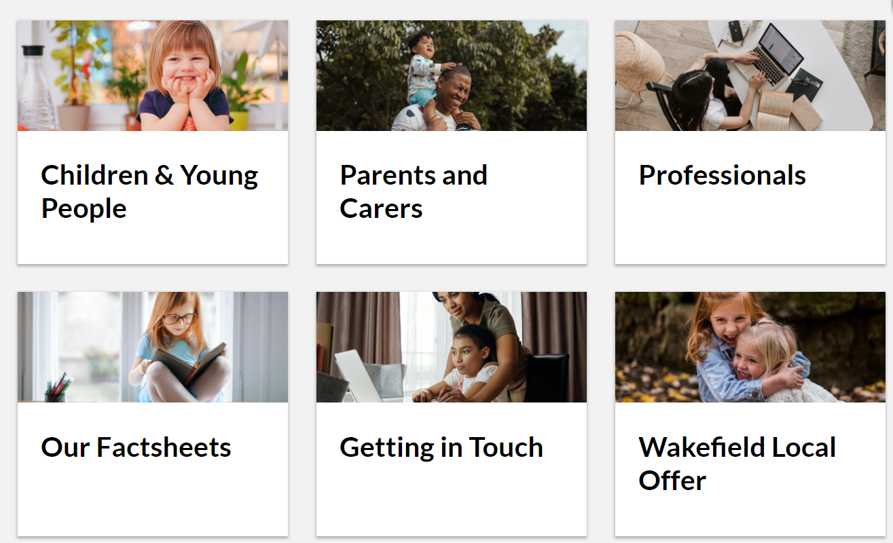
Sendiass website areas

Slide 8
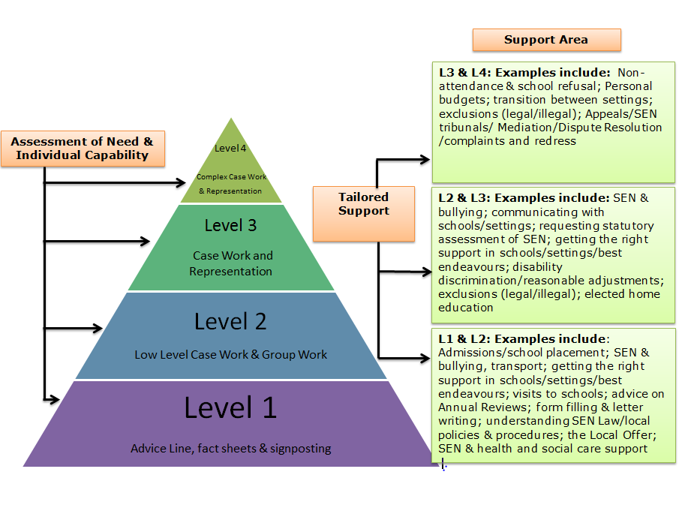
Sendiass flowchart
Family not in our area or due to transition out? All local authorities have a legal duty to provide SENDIASS

Slide 9
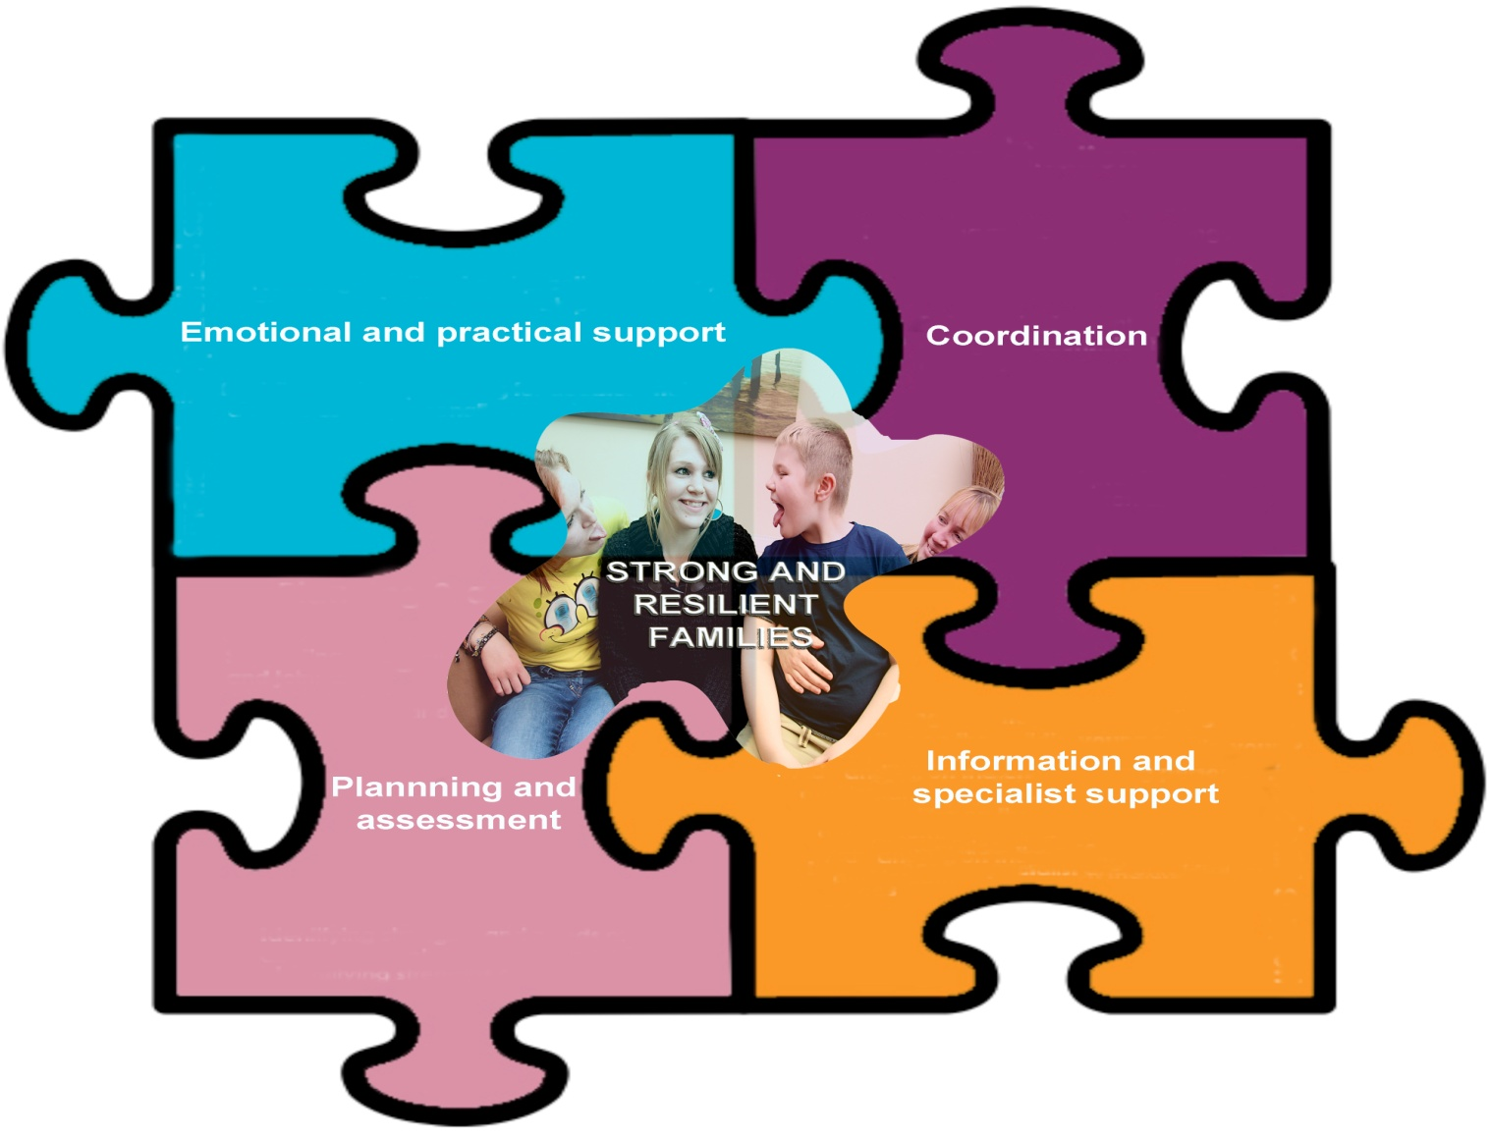
Keyworking

Slide 10
Keyworking referral criteria
Essential criteria
Please note child MUST have seen a paediatrician and there is a recognisable additional need
Two or more professionals from specialist agencies
*Paediatrician *Physiotherapy *Occupational Therapy
*Speech Therapy *Dietician *Portage *LD Nurse *Community Nurse *Early Years SEND
**Unfortunately we do not offer direct behaviour support as part of our service**
Not all families who have a child with disabilities/additional needs will need a keyworker, we will only get involved when there is a role for us
To accept a referral there also needs to be an element of coordination required.
For example:
Early Support (Family file, appointments, co-ordinate apps)
Liaison with professionals
Facilitating/attend Multi-agency Meetings
PLANNING AND ASSESSMENT
You may have a need for this as part of a referral but not required
*My Support Plans
*Short break referrals
What we can offer
EMOTIONAL AND PRACTICAL SUPPORT
Support for hospital appointments
Grants, Benefits & Entitlements
Special needs housing/adaptations
Early Support
We can also provide
INFORMATION & SPECIALIST SUPPORT
Special needs housing
Referrals to other services

Slide 11
Workshops
Examples for parents/carers
Offered in a range of venues across Wakefield at a range of times to meet needs
Behaviour (T.C.I)
Anxiety & self harm (CAMHS)
Intro. To ASD & Intro. To ADHD
Improve your child's sleep
Balancing act
Distant Learning packages are being developed
For siblings of children with SEND are also available
Book via Eventbrite –more details on the local offer
Other ideas of what you’d like to see?
We welcome your feedback ☺
Notes:
Parent's/carers have priority over places but professionals can book on also
TCI-therapeutic crisis intervention CAMHS –Child and adolescent mental health service. Refer to workshop brochures

Slide 12

Local offer
The local offer website is a legal requirement that provides information and support available for families with children and young people aged 0-25 years with special educational needs and/or disabilities in the Wakefield district

Slide 13
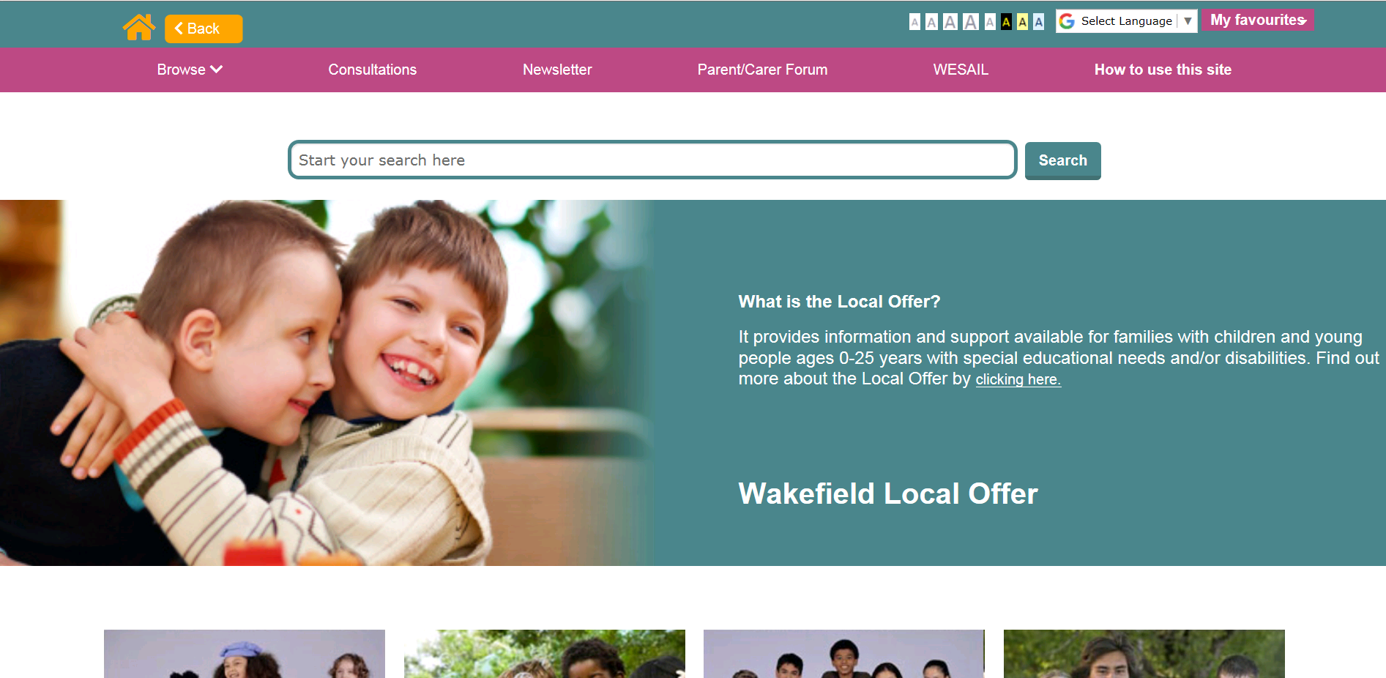
Wakefield Local Offer
http://wakefield.mylocaloffer.org/Home

Slide 14
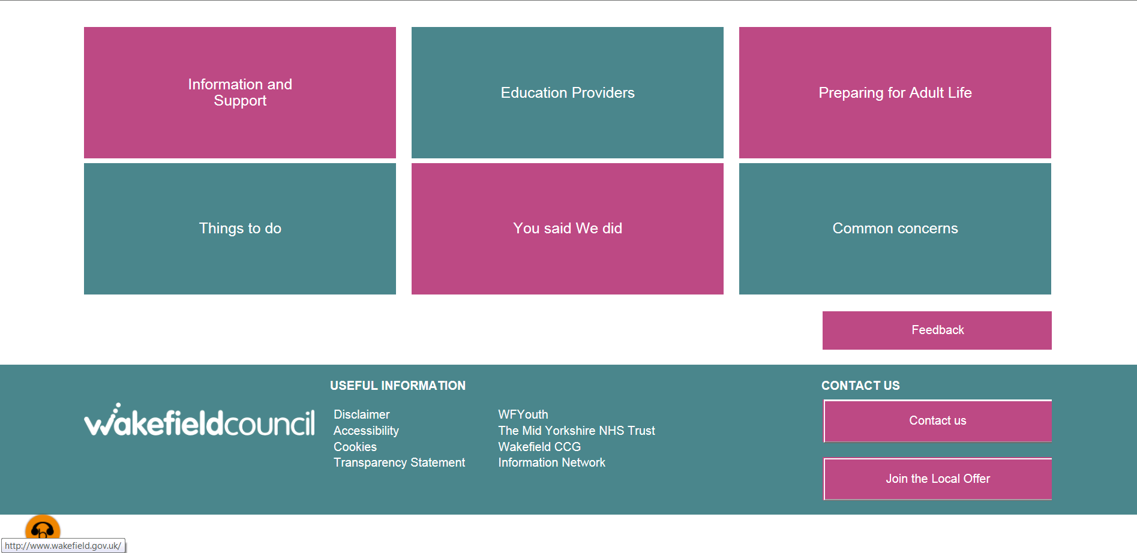

Slide 15
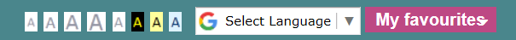
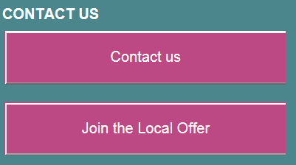
Highlights to remember
How to use this site
Common concerns
Accessibility:
Google translate
Font change (size/colour)
Browsealoud
Feedback
My favourites
Print booklet
Notes:
Over 100 languages available for translation
Pink boxes at bottom right of homescreen and every page
Browsealoud bottom left orange icon

Slide 16
Wakefield's Local Offer is more than just a website
We produce a newsletter known as “News and Views”
We hold Local Offer Live events with providers who are part of the Wakefield Local Offer to give young people, families and the people who work with them the opportunity see what is on offer and to speak to the providers and ask questions
Use social media with up to minute information and announcements about the Local offer including relevant consultation exercises, engagement opportunities, Listening Events and events like Local Offer Live

Slide 17
News & Views
Is a quarterly newsletter which features key services, support, activities, events and news about what is available in the local area
Any service can contribute to this
Stories and ideas from parents/carers and young people are also welcomed
Hard copies are distributed via events and posted to those on the information network (disabled children’s register)
Requests for copies can be made via the advice line
Shared virtually via Facebook pages
Back copies available on the local offer website
Contact: Usha Gough Local offer Lead -wakefieldlocaloffer@barnardos.org.uk
Notes:
If you sign up to the Wakefield Information Network (IN), you get a copy of the newsletter before it appears on the website along with advance details of planned events.
The IN is also the Disabled Children’s Register which the council has a statutory duty to have and keep up to date. The register is voluntary for families to join but helps inform decisions about new and existing services across the Wakefield district.
Practitioners who work with families with children and young people with additional needs can also sign up to the IN to receive an email copy of the newsletter.

Slide 18
Inclusion worker
Purpose of role:
To ensure parents/carers, children/young people & professionals using our service have the chance to feed into the development of the service
Involve everyone through a variety of ways including social media, phone interactions and face to face events
Feedback on our services is gathered after cases are closed and after events
Contact: anna.harrison@barnardos.org.uk

Slide 19
How can you support us?
Join the LO or ensure your existing information is accurate & up to date
Become a LO Champion
Contribute articles to the “News & views” newsletter
Accurate signposting –if in doubt, check it out via advice line
Like, follow and share information on our social media sites
Join the information network (disabled children’s register) to receive up to date information

Slide 20
Thanks for listening!
Barnardo’s
Wakefield Early Support, Advice, Information & Liaison service
01924 304152
WESAIL@barnardos.org.uk
https://www.barnardos.org.uk/wesail-wakefield
@WESAILWakefield

